Slide 1
Modeling Gamma-Ray Absorption and Scattering in a Concrete Structure
Darrell Stepter

Slide 2
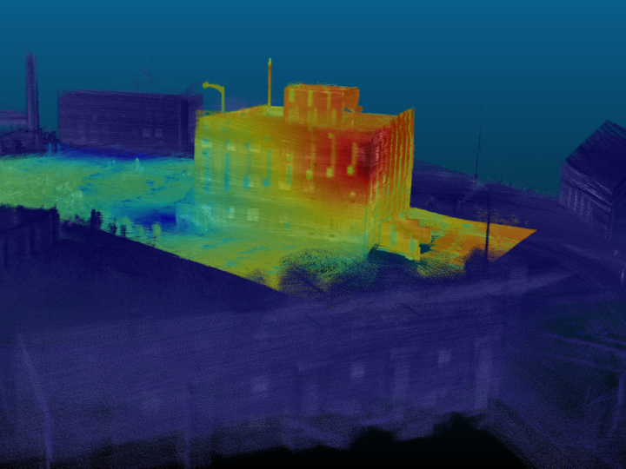
MOTIVATION: Gamma “Heat Map” produced by LAMP on drone
Unmanned Search Technology Demonstration at Camp Roberts
Unknowns:
Source
Source Activity
Source Location
Building Geometry
Building Materials
This image generated two questions?
How do we know this is correct?
Can we differentiate between attenuated/transmitted and scattered gammas?
Can we use this information to calculate Source Activity and Location?
*Photo provided by Andrew Haefner

Slide 3
METHODOLOGY: Model and Validate in a Controlled Scenario
Model:
Build accurate model eliminating unknowns (Source, Activity, Location, Geometry, and Materials)
Run simulation to calculate instantaneous flux at detector.
Answers Question #1
Segregate simulation results (i.e. by energy or last location) and compare results to examine gamma absorption and scattering
Answers Question #2
Validation:
Mathematically validate model using known flux/count-rate equations
Conduct real world measurement using same parameters
PROBLEM: No control, access, blueprints, material information for Camp Roberts
SOLUTION: Find Surrogate Structure and Develop Simulation

Slide 4
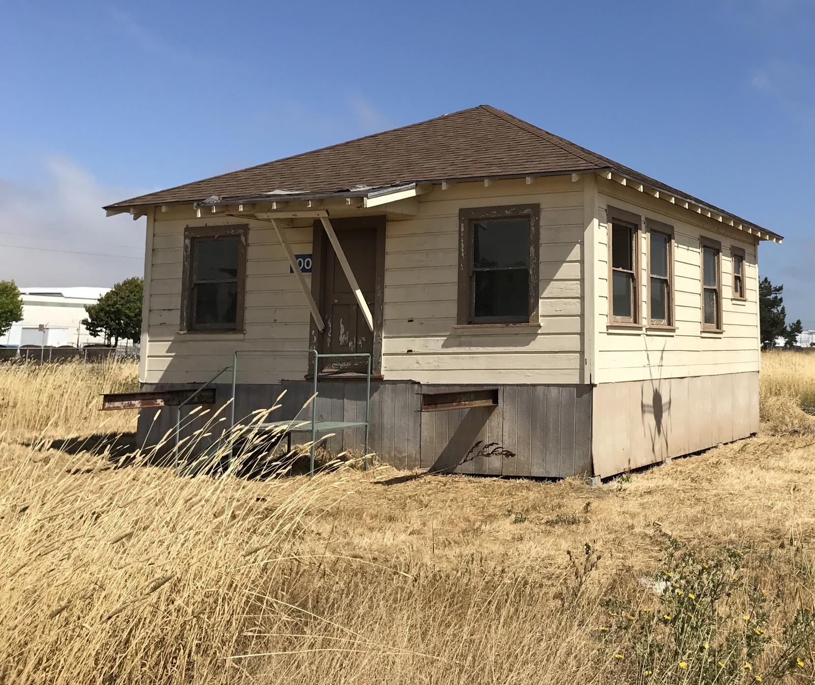
SURROGATE Structure: Building 100 at Richmond Field Station
Pros:
Control
Known Geometry
Cons:
Unknown Building Materials*
Unknown understructure
Measurement Error
*Besides standard materials (wood, glass, etc.), other materials (paint, grass, etc.) are of unknown composition and hard to model.
NEW SOLUTION: Develop Simulation and build Surrogate Structure

Slide 5
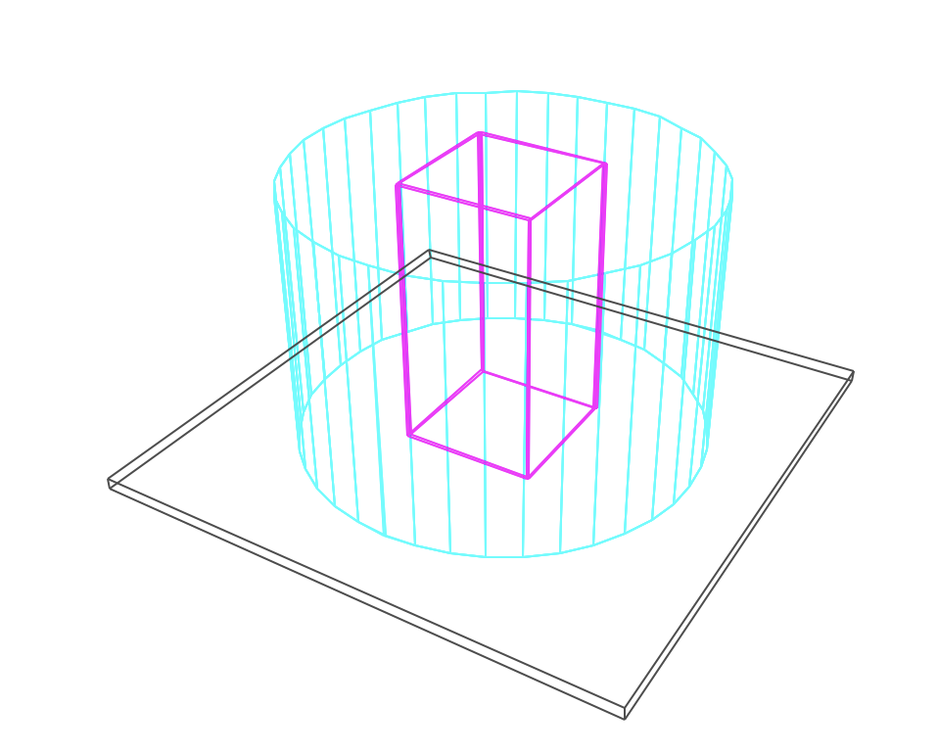
SURROGATE Structure: Concrete Building on Asphalt Surface
Pros:
Known Geometry
Known Materials
Easily Replicated in real world
Cons:
Simple Geometry does not reflect real world
Building is 10m tall with 5m length walls. “Detector” is 10m tall ideal blackbody absorber (100% efficiency) with 7.5m radius. Source is modeled as point source centered in building 2.6m above ground plane.

Slide 6
SURROGATE Structure: Materials
Concrete, Ordinary (NIST)
Density: 2.3 g/cm³
Weight Fractions:
H 0.022100
C 0.002484
O 0.574930
Na 0.015208
Mg 0.001266
Al 0.019953
Si 0.304627
K 0.010045
Ca 0.042951
Fe 0.006435
Asphalt Pavement
Density: 2.5784 g/cm³
Weight Fractions:
H 0.007781
C 0.076175
N 0.000363
O 0.459103
Na 0.011659
Mg 0.021757
Al 0.051009
Si 0.231474
S 0.002804
K 0.017058
Ca 0.084471
Ti 0.003403
V 0.000024
Mn 0.000362
Fe 0.031375
Ni 0.000002
Pb 0.001179

Slide 7
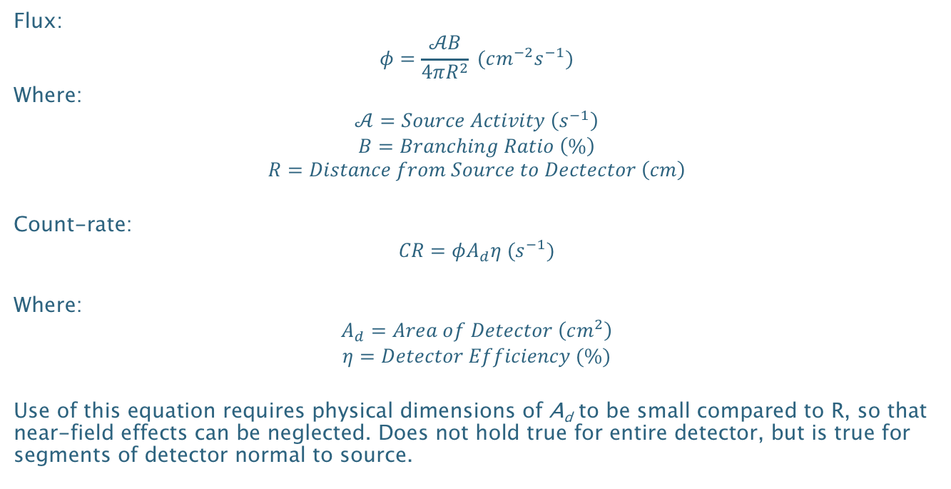
CODE VALIDATION: Mathematical Flux and Count-rate Calculations
Flux:
$$φ=\frac{𝒜B}{4πR^{2}} (cm^{−2}s^{−1})$$
Where:
$$𝒜=Source Activity \left(s^{−1}\right)$$
$$B=Branching Ratio \left(\%\right)$$
$$R=Distance from Source to Dectector \left(cm\right)$$
Count-rate:
$$CR=φA_{d}η (s^{−1})$$
Where:
$$A_{d}=Area of Detector \left(cm^{2}\right)$$
$$η=Detector Efficiency (\%)$$
Use of this equation requires physical dimensions of A_{d} to be small compared to R, so that near-field effects can be neglected. Does not hold true for entire detector, but is true for segments of detector normal to source.
*Morse, Analytical Methods for Nonproliferation, pg. 24
Notes:
Flux equation is an approximation with particles traveling in 4𝜋 space and the area of the transit area as 4𝜋R². However, in reality, the area at R is a square on a spherical surface and the actual area is $A=R^{2}\int_{φ_{1}}^{φ_{2}}{\int_{θ_{1}}^{θ_{2}}{\sin{θ}dθ dφ}}$

Slide 8
CODE VALIDATION: Mathematical Flux and Count-rate Calculations
Simulating ⁶⁰Co source producing 3 million gammas, 100% Branching Ratio for 1.332 MeV Gamma, 7.5 m distance, and 40cm * 3° (1570.8 cm²) Detector Area, and 100% efficiency.
Expected: 666.66 Expected Counts
Calculated: 668.21 Mean Counts, 24.87 St. Dev.
Notes:
Explain how model works
Run Sim
Parse by hits
Convert Cartesean to Cyclindrial
Histogram Response

Slide 9
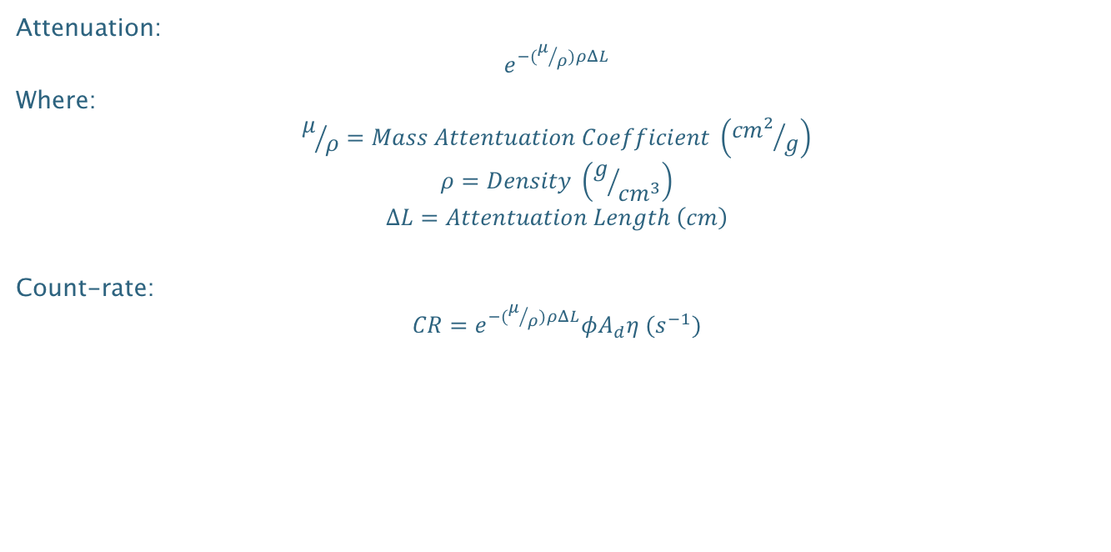
CODE VALIDATION: Mathematical Flux and Count-rate Calculations with Attenuation
Attenuation:
$$e^{−(μ/ρ)ρΔL}$$
Where:
$$μ/ρ=Mass Attentuation Coefficient \left({{cm}^{2}}/g\right)$$
$$ρ=Density \left(g/{{cm}^{3}}\right)$$
$$∆L=Attentuation Length \left(cm\right)$$
Count-rate:
$$CR=e^{−(μ/ρ)ρΔL}φA_{d}η (s^{−1})$$

Slide 10
CODE VALIDATION: Mathematical Flux and Count-rate Calculations with Attenuation
0.062 Mass Attenuation Coefficient, 2.3 g/cm3 Density, and 10 cm Attenuation Length.
Expected: 230.13 Expected Counts
Calculated: 232.92 Mean Counts, 14.44 St. Dev.
*Mass Attenuation Coefficient for Concrete, Ordinary (NIST) from https://physics.nist.gov/PhysRefData/Xcom/html/xcom1.html

Slide 11
GEOMEGA MODEL: Segregating Simulation Data – Based off Energy and Last Location
Full Energy Deposition
Partial Energy Deposition – Concrete Scattered
Partial Energy Deposition – Asphalt Scattered
Notes:
Explain what don’t see – double attenuatiuon

Slide 12
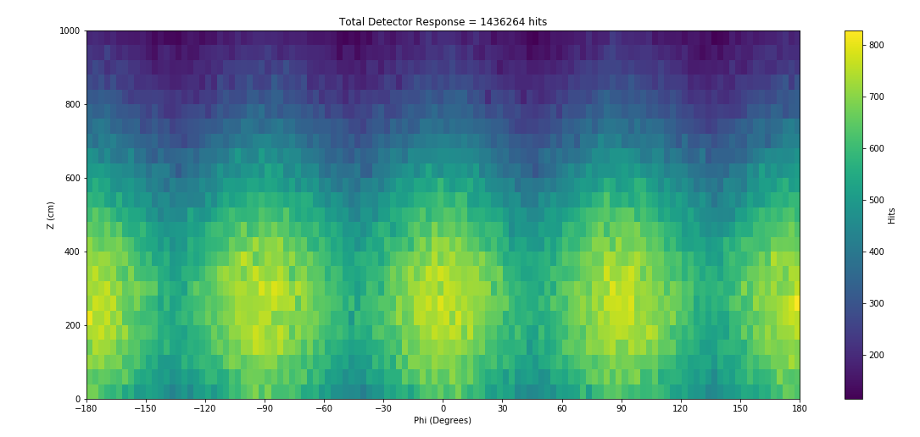
SIMULATON RESULTS: ⁶⁰Co Source 4 Million 1.332 MeV Particles Generated

Slide 13
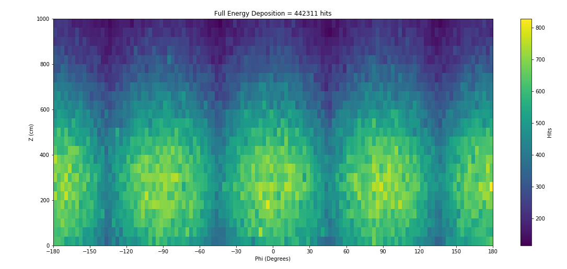
SIMULATON RESULTS: ⁶⁰Co Source 4 Million 1.332 MeV Particles Generated

Slide 14
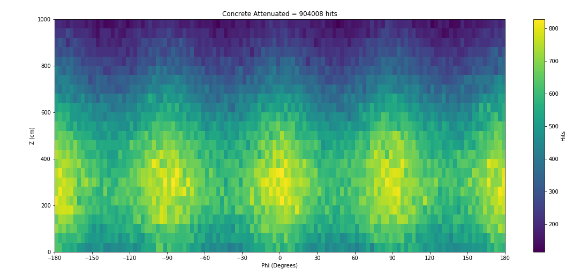
SIMULATON RESULTS: ⁶⁰Co Source 4 Million 1.332 MeV Particles Generated

Slide 15
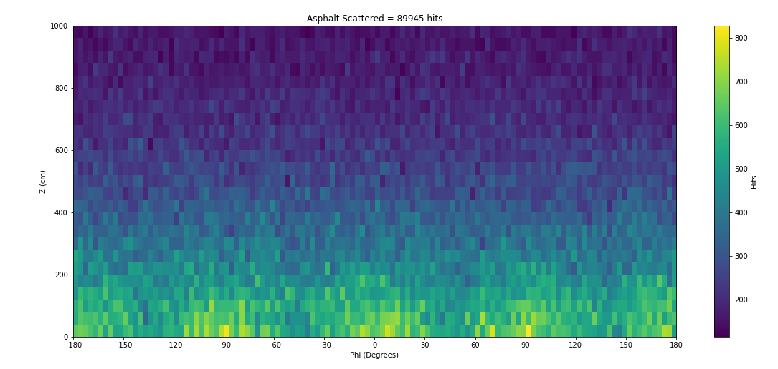
SIMULATON RESULTS: ⁶⁰Co Source 4 Million 1.332 MeV Particles Generated

Slide 16
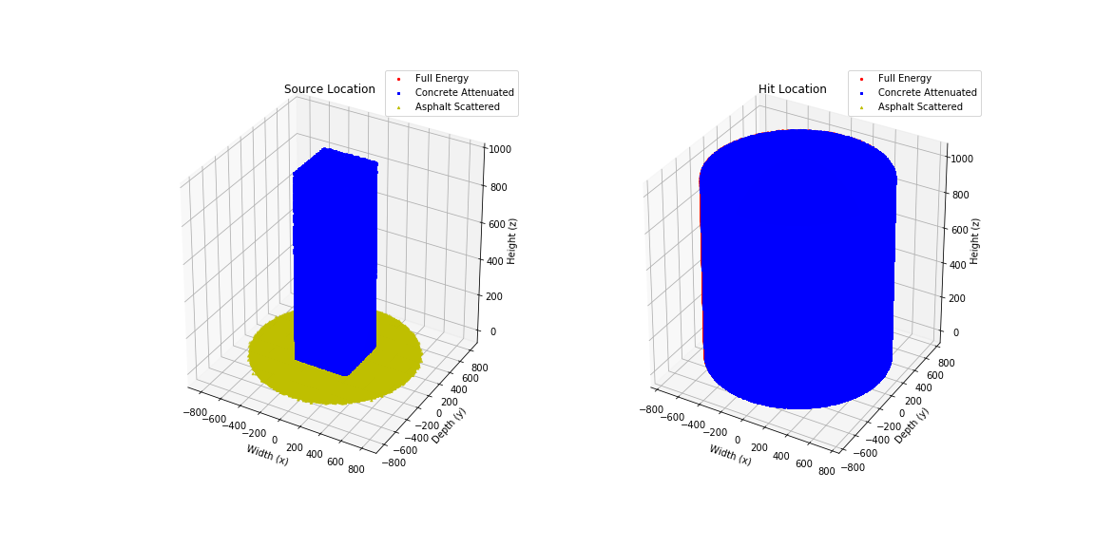
SIMULATON RESULTS: Last Location of Gammas and Energy Heatmap
Notes:
Explain plain-intercept back projection.

Slide 17
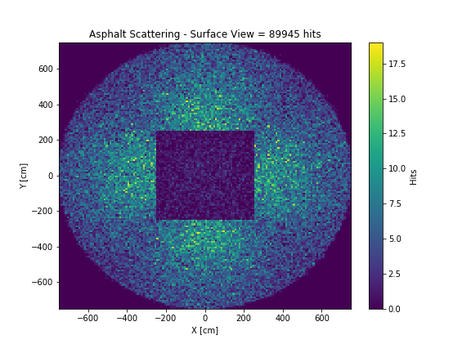
SIMULATON RESULTS: Alternate Flux Heatmap - Still trying to convert to 3D
Notes:
Explain features

Slide 18
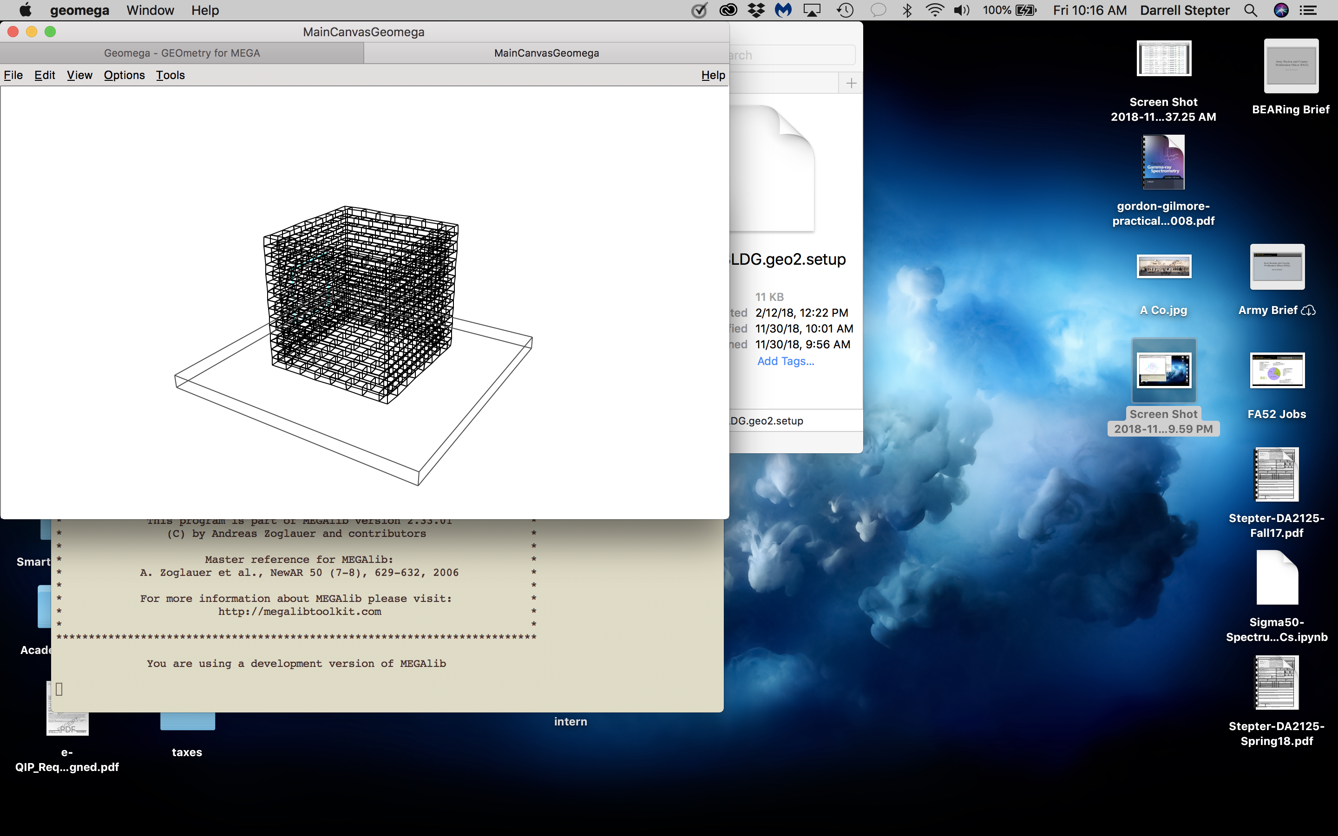
FUTURE WORK: Build Surrogate Structure and Conduct Measurements
Design:
Chimney 1m x 2m on Asphalt pad
Small size eliminates need for bonding agent
Preexisting pad eliminates need to lay pavement
Use commercially available “Red Concrete” and “Clay” bricks
Allows evaluation of scattering through two material compositions
***Do not know exact composition of bricks*** - Mass Spectrometry
Model:

Slide 19
Questions?

